Slide 1


Vivekanand Education Society’s Institute Of Technology Department Of Information Technology
Flutter Presentation
Title: Blogger App
Mentor : Dr. Ravita Mishra
Presented by :
Shantanu Saraf

Slide 2








Abstract
Introduction
Objectives
Overview
Software Requirements
Implementation
Future Scope
Conclusion
Reference

Slide 3

Abstract
In today's fast-paced world, blogging has become a powerful medium for individuals to express ideas, share experiences, and connect with a global audience. This project focuses on the creation of a versatile blogger application using Flutter and Firebase, enabling users to effortlessly create, publish, and manage their blogs.
The app aims to provide a seamless writing experience with features like rich text editing, multimedia integration, and real-time collaboration. By offering a platform that prioritizes user-friendly interface and robust functionality, this blogger app seeks to empower users to unleash their creativity and engage with a vibrant community of bloggers.

Slide 4

Introduction
In today's digital landscape, blogging has evolved into a powerful medium for individuals to express their ideas, share stories, and connect with like-minded individuals. This project unveils a cutting-edge blogger application built on the Flutter framework, offering a seamless and intuitive platform for users to create, edit, and publish their content. With features such as real-time collaboration, multimedia integration, and customizable themes, our app aims to revolutionize the blogging experience, empowering users to unleash their creativity and engage with a global audience like never before.

Slide 5
Objectives
1
2
3
Seamless Content Creation
Community Engagement
Advertisement Integration
Enable users to easily create and edit blog posts with a user-friendly interface and rich text editing capabilities.
Facilitate interaction between bloggers and readers through comments, likes, and sharing features to foster a vibrant blogging community.
Provide tools for bloggers to easily integrate advertisements into their blogs, including display ads, sponsored content, and affiliate links, to monetize their blogs effectively.

Slide 6
Objectives
4
5
6
Analytics and Insights
Mobile Accessibility
Sponsorship Opportunities
Provide in-depth analytics and insights into blog performance, audience demographics, and engagement metrics to help bloggers refine their content strategy.
Ensure the app is fully optimized for mobile devices, allowing users to manage their blogs on the go
Facilitate partnerships between bloggers and brands for sponsored content and promotional campaigns, creating additional revenue streams for bloggers.

Slide 7
SOFTWARE REQUIREMENTS
Flutter SDK
Visual Studio Code
Firebase
Dart Programming Language
Flutter Packages and plugins
Git

Slide 8
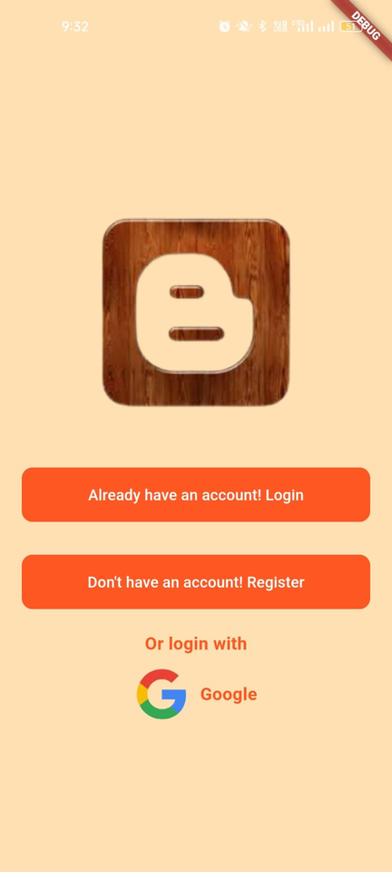
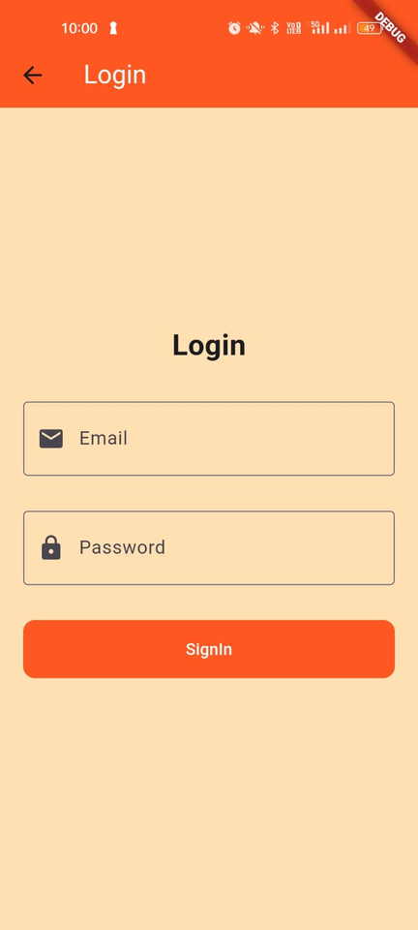
Implementation
Login and Register Page
Clean Interface: Designed for easy navigation and user-friendly experience.
Login Form: Existing users can enter their username and password to access their account.
Registration Form: New users can fill in their details, such as username, email, and password, to create an account.
Social Login: Option to log in using existing Google account for quick access.
Validation Checks: Ensure entered information is accurate and meets app's requirements.
Google Integration: Enable users to log in/register using their Google account for seamless authentication.

Slide 9
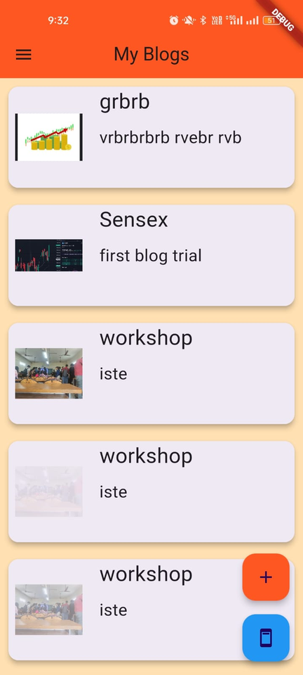
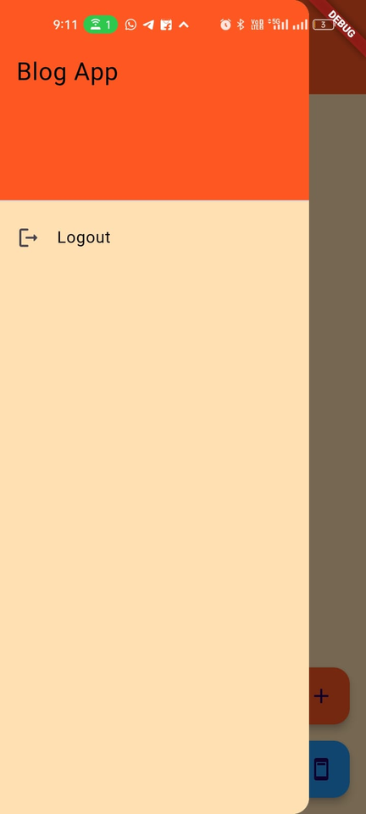
Implementation
Home Page
All Blogs Display: Shows a feed of all blogs from various users for easy browsing.
Upload Blog Button: Allows users to create and publish new blogs directly from the home page.
Advertising Button: Provides access to advertising options for bloggers to monetize their content.
Navigation Bar: Includes a logout button for users to securely sign out of their account.

Slide 10
Implementation
Home Page
All Blogs Display: Shows a feed of all blogs from various users for easy browsing.
Upload Blog Button: Allows users to create and publish new blogs directly from the home page.
Advertising Button: Provides access to advertising options for bloggers to monetize their content.
Navigation Bar: Includes a logout button for users to securely sign out of their account.

Slide 11
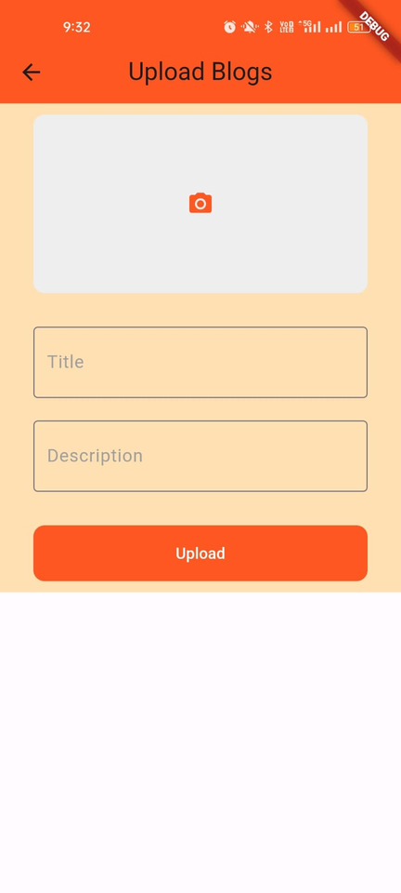
Implementation
Upload Blog Page
Description Field: Allows users to write the content of their blog using a rich text editor for formatting options.
Image Upload Options: Provides buttons to upload images from the device's gallery or capture new images using the device's camera.
Title Field: Enables users to enter a title for their blog post, making it easier for readers to identify the content.

Slide 12
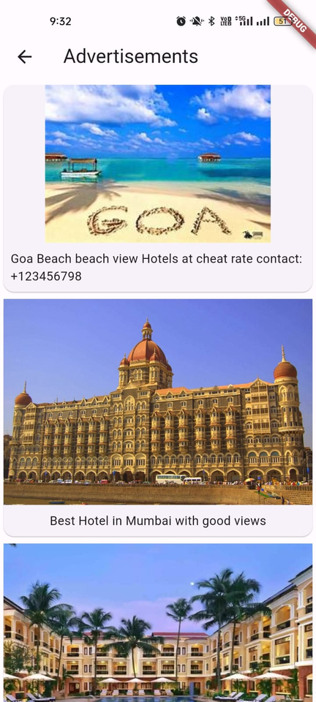
Implementation
Advertisement Page
Advertisement Display: Shows a list of advertisements with photos and descriptions.
Upload Advertisement Button: Allows advertisers to upload new advertisements.
Advertisement Details: Displays each advertisement's photo, description, and other relevant information.

Slide 13

Future Scope
Enhanced Analytics: Introduce advanced analytics tools for bloggers to gain deeper insights into their audience, engagement metrics, and content performance.
Integration with Social Media: Integrate with popular social media platforms to allow users to share their blog posts and engage with their audience across multiple channels.
Community Building: Enhance community features to foster a more interactive and engaged user base, including forums, events, and networking opportunities.

Slide 14
Literature Survey
Name | Author | Description
Research on the Application of Blog for University Students' Information Literacy Education |  | This paper explores the use of blogs for university students' information literacy education, including posting guidelines and authentication practices.
A Clean Approach to Flutter Development through the Flutter Clean Architecture Package | S. Boukhary and E. Colmenares | This paper proposes a new Flutter architecture based on the Clean Architecture by Uncle Bob, offering a solution for state management issues, and provides guidance on building, running, and integrating Flutter apps using this architecture.
W. Li and T. Wang

Slide 15
Conclusion
In conclusion, the blogger app presents a comprehensive platform for individuals to express their thoughts, share experiences, and connect with a global audience. With its user-friendly interface, rich features for content creation and management, the app empowers users to unleash their creativity and build a thriving online presence. Looking ahead, the app's future scope includes advanced analytics, collaboration tools, and enhanced community features, ensuring that it remains a valuable tool for bloggers seeking to make an impact in the digital world.

Slide 16

REFERENCE
Blogging App using the Blogger API using Flutter.
Design and Development of a User-Friendly Social Media App using the MERN Stack
This paper reviews a MERN stack social networking site with image posting, liking, comments, and reviews, showcasing its fast, secure, and interactive features.
APPLICATION DEVELOPMENT USING FLUTTER

Slide 17

Thank You

Slide 18
Vivekanand Education Society’s Institute Of Technology Department Of Information Technology
PWA Presentation
Title: Fashionify (Ecommerce Website)
Mentor : Dr. Ravita Mishra
Presented by :
Shantanu Saraf

Slide 19
FEATURES
1
2
3
Fast Load Times
Offline Functionality
Push Notifications
Register and activate the service worker to intercept network requests, allowing cached resources to load quickly and improving overall performance.
Implemented a service worker to cache essential resources, enabling offline access to your E-commerce PWA even in low or no internet connectivity scenarios
push events to deliver timely notifications to users, keeping them informed about new offers, promotions, or updates

Slide 20
FEATURES
4
5
6
Installation
App-like Interface
Security
Users can install PWAs on their device's home screen without going through an app store, saving storage space and offering easy access.
PWAs provide a native app-like experience, including smooth animations and interactions.
PWAs are served over HTTPS, ensuring that data is transmitted securely.

Slide 21
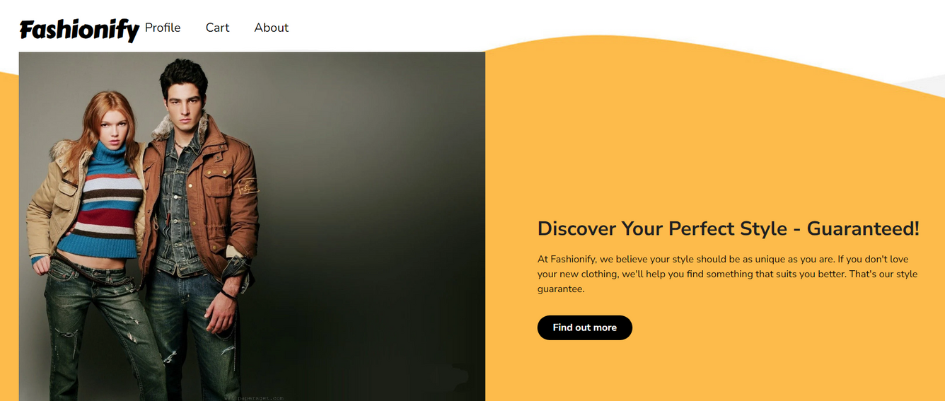
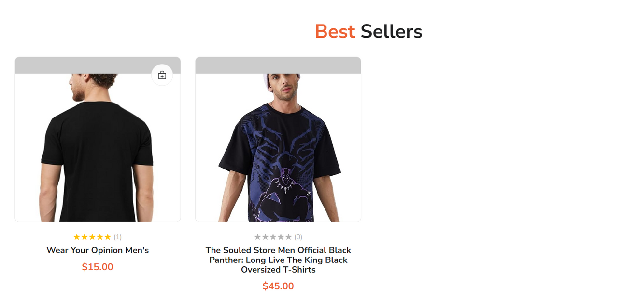
Implementation
Home Page

Slide 22
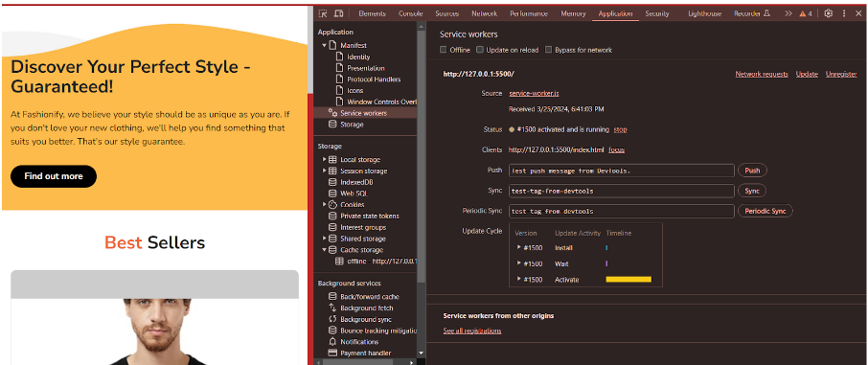
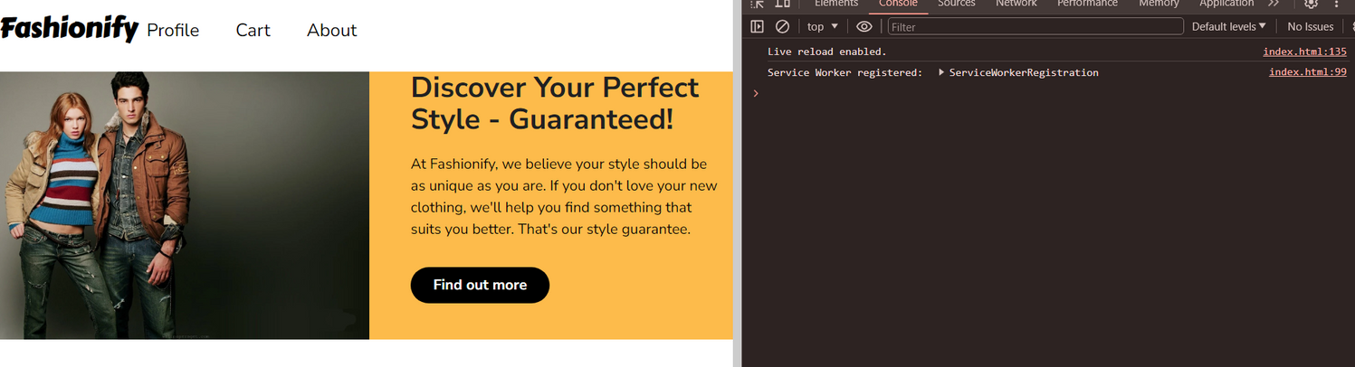
Implementation
service worker

Slide 23
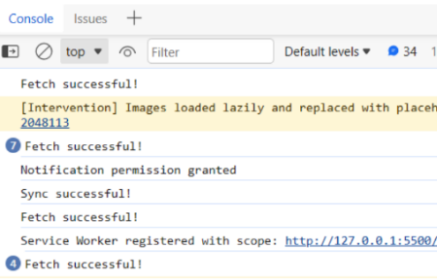
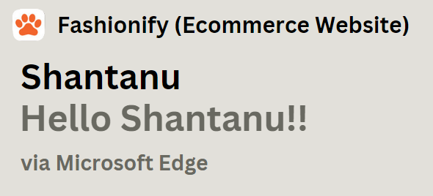
Implementation
fetch, sync and push

Slide 24
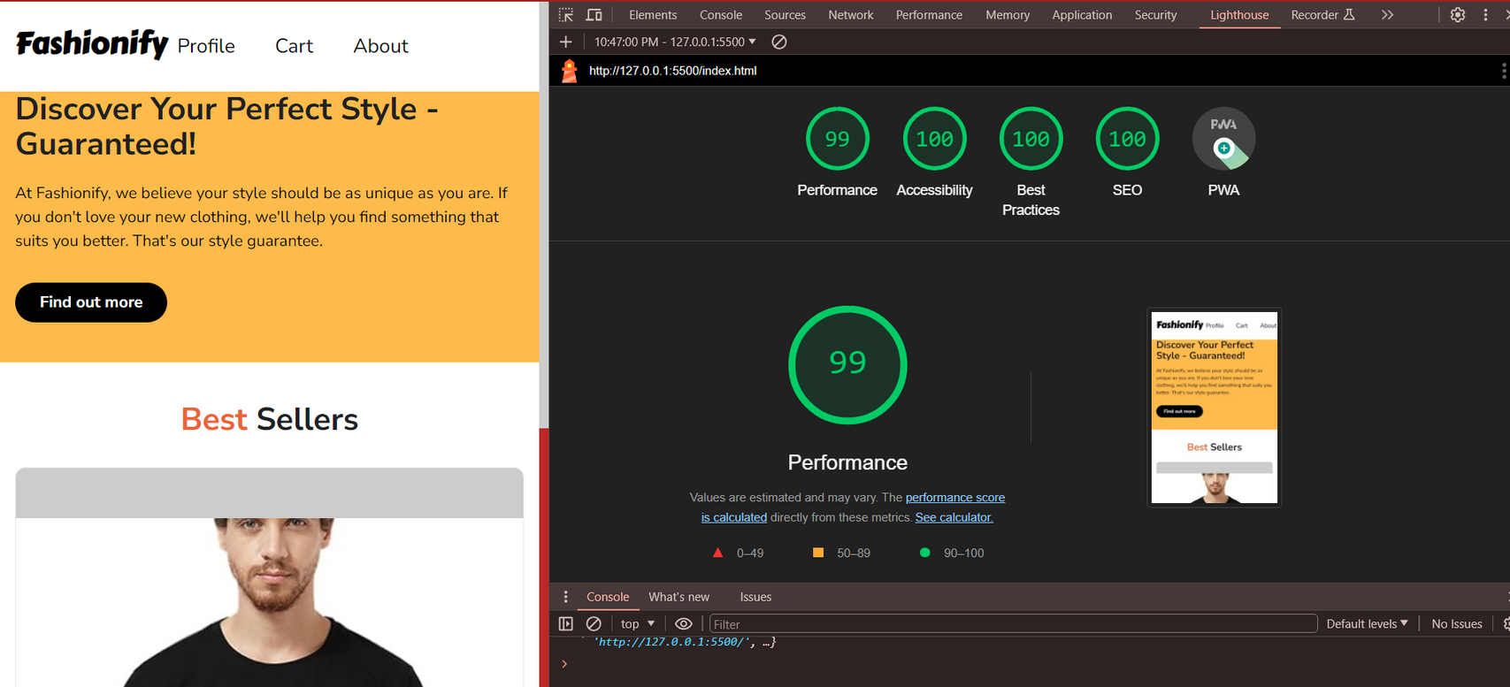
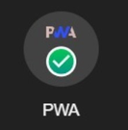
Implementation
Light House Report

Slide 25
Thank You

